Slide 1
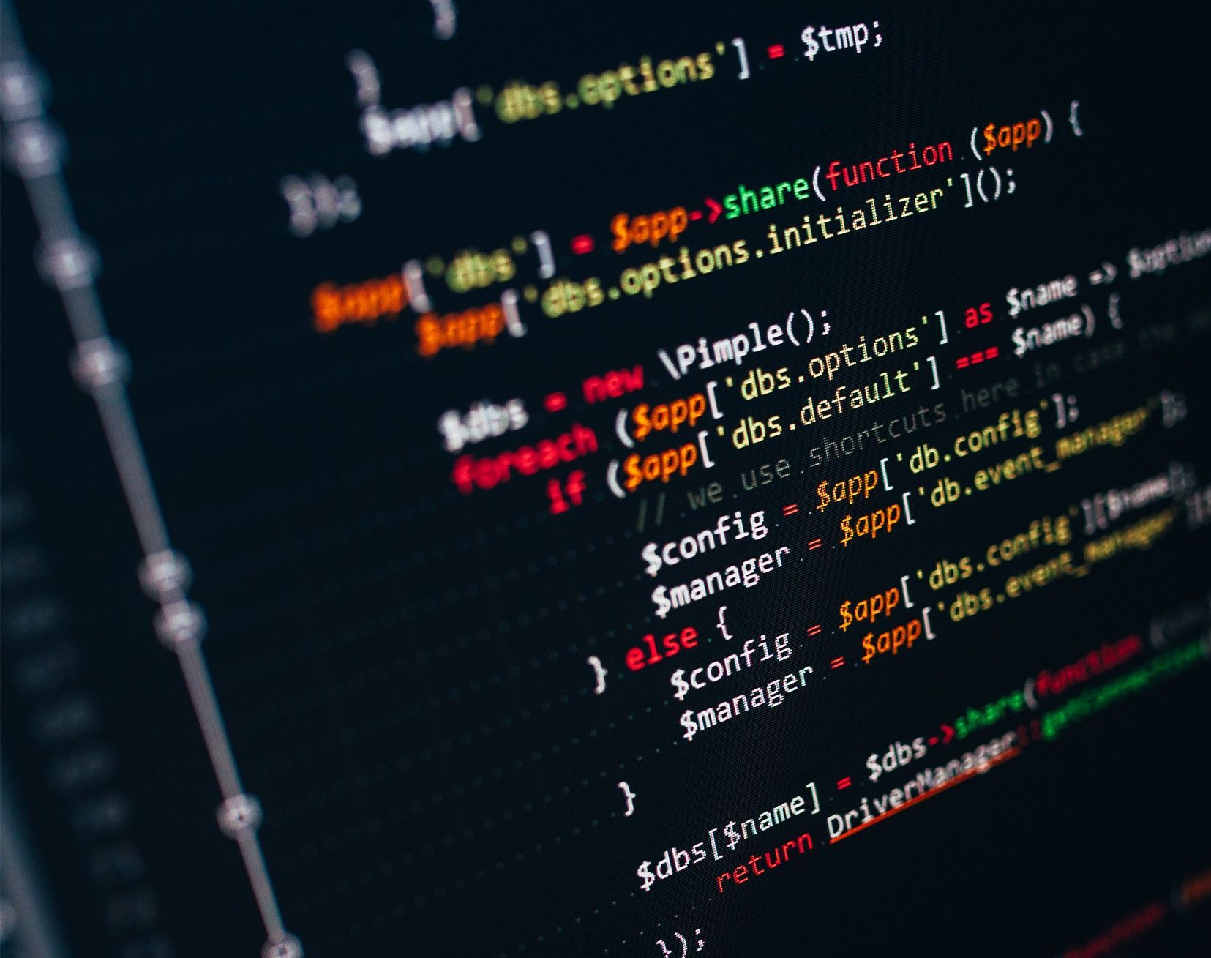

GameSAT
Play to learn.

Slide 2

Overall Project

Slide 3


Implementation Plan
Android Studio
Java
MySQL
Project Management:
Jira

Slide 4
Implementation Plan - Testing
JUnit
Black-Box Testing

Slide 5
Concerns
Security
Protecting user information
Preventing SQL injection
This version will only work in Android devices

Slide 6
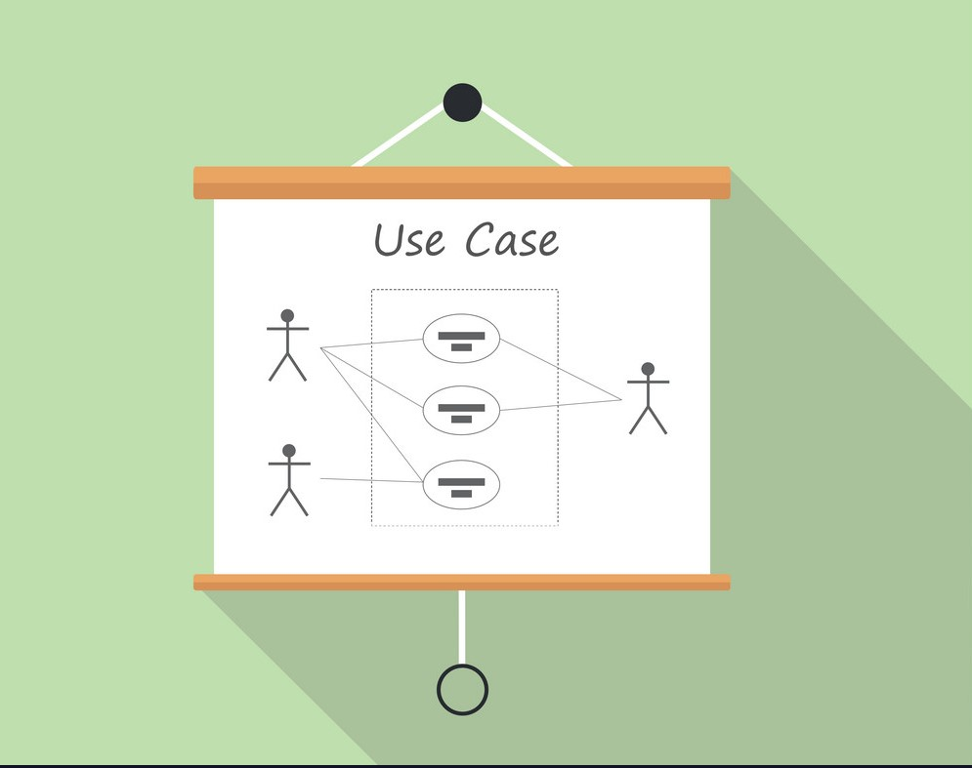
Use Case Diagram

Slide 7

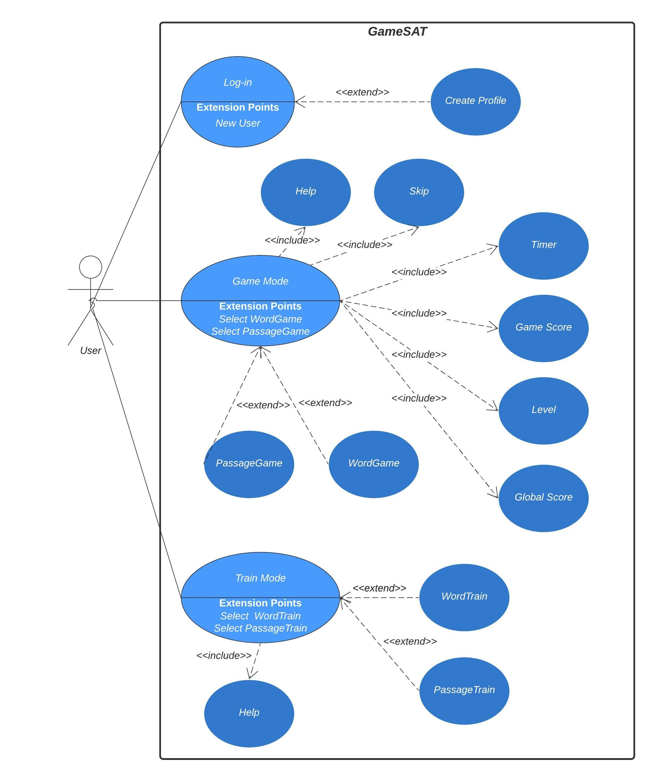
Overview

Slide 8
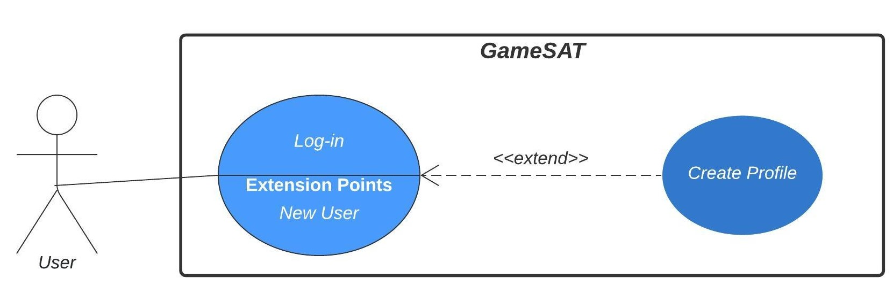
Profile Management
Existing users can simply Log-in to the game
New users are offered to create a profile for data management

Slide 9
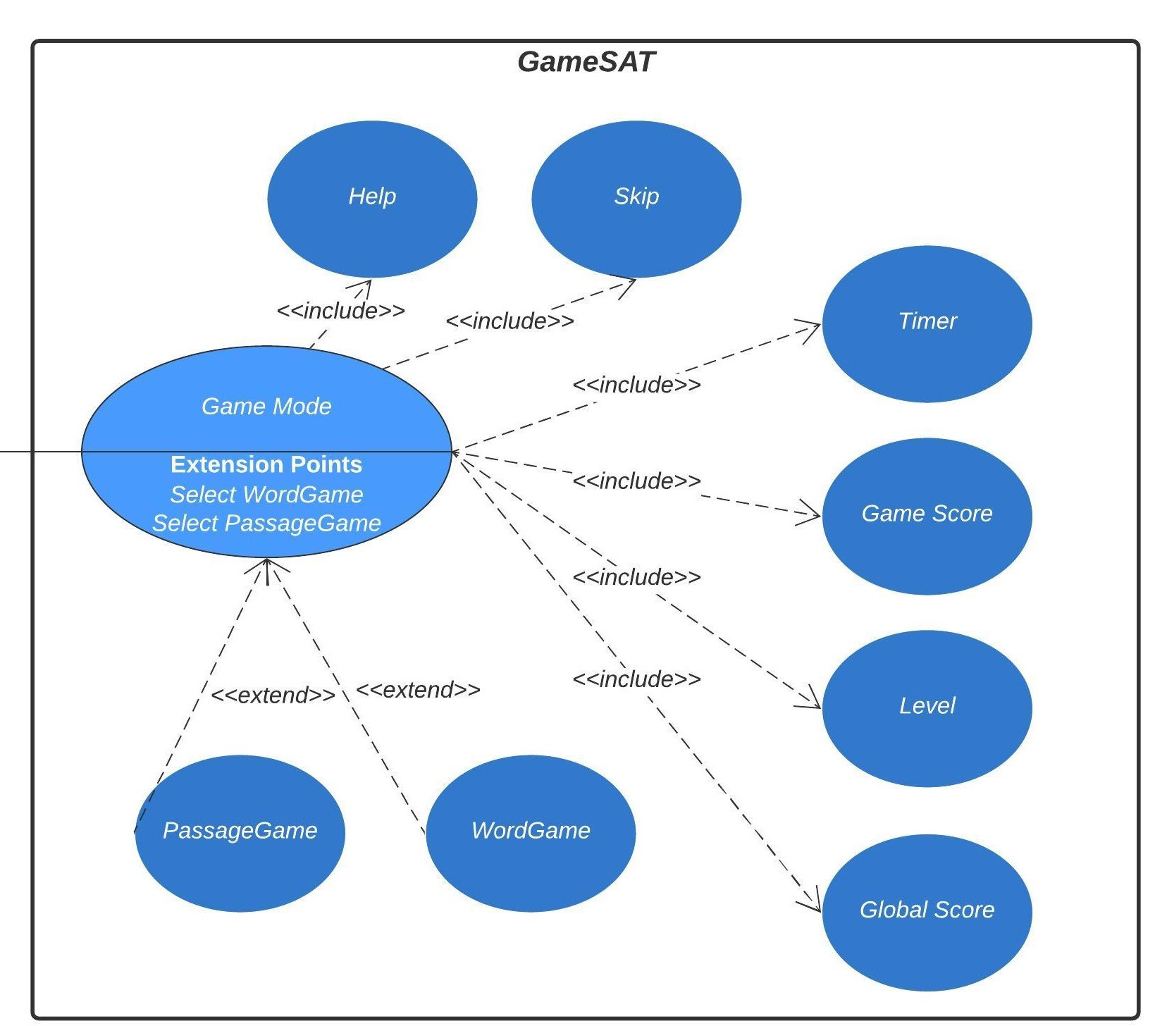
Game Mode
The user can play a word or passage game
The user can skip questions
The user's choices are scored
The user's answers are timed

Slide 10
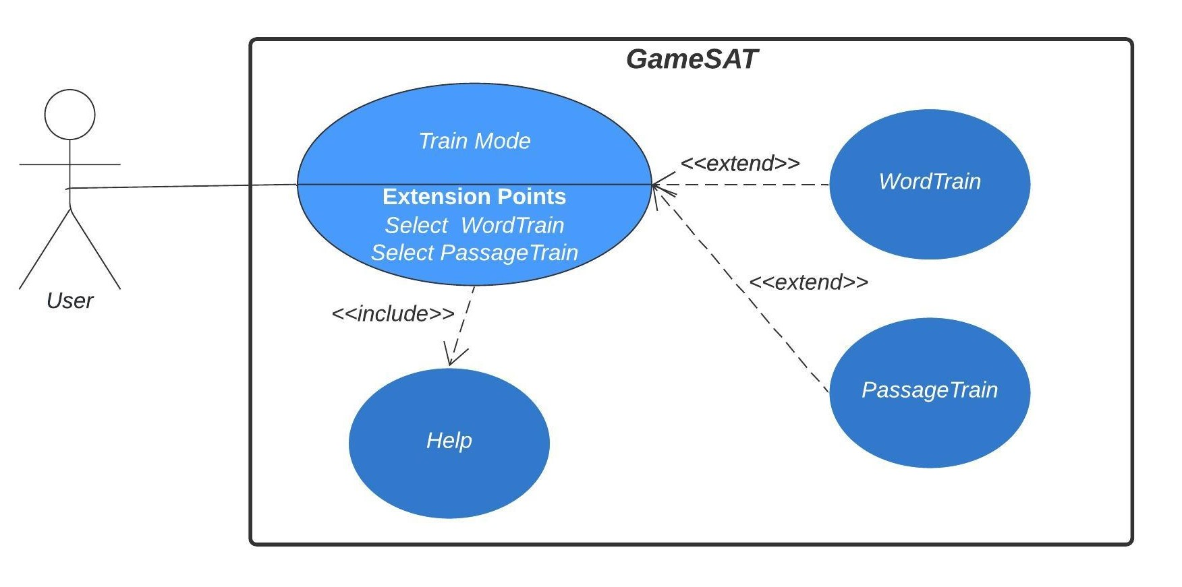
Train Mode
The user can train in word vocabulary
The user can train in passage comprehension

Slide 11

Class Diagram

Slide 12
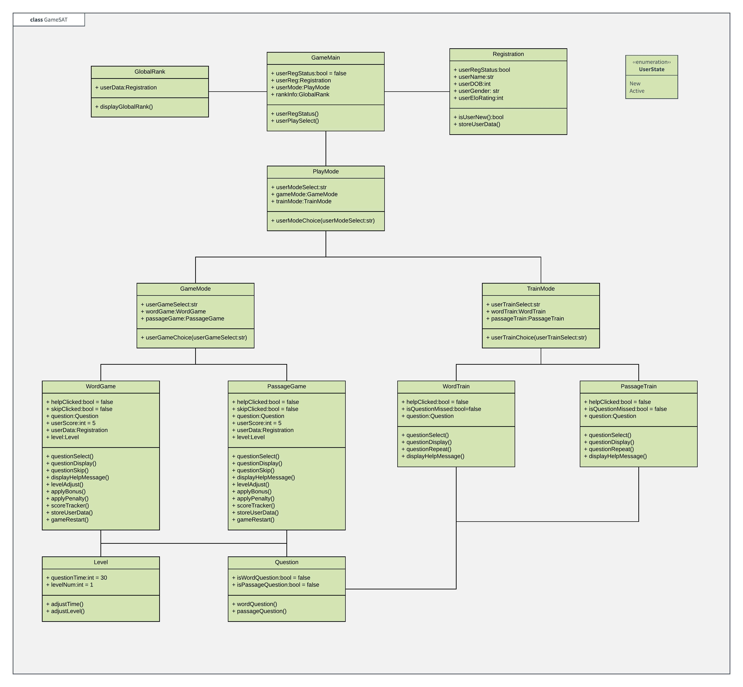
Overview

Slide 13
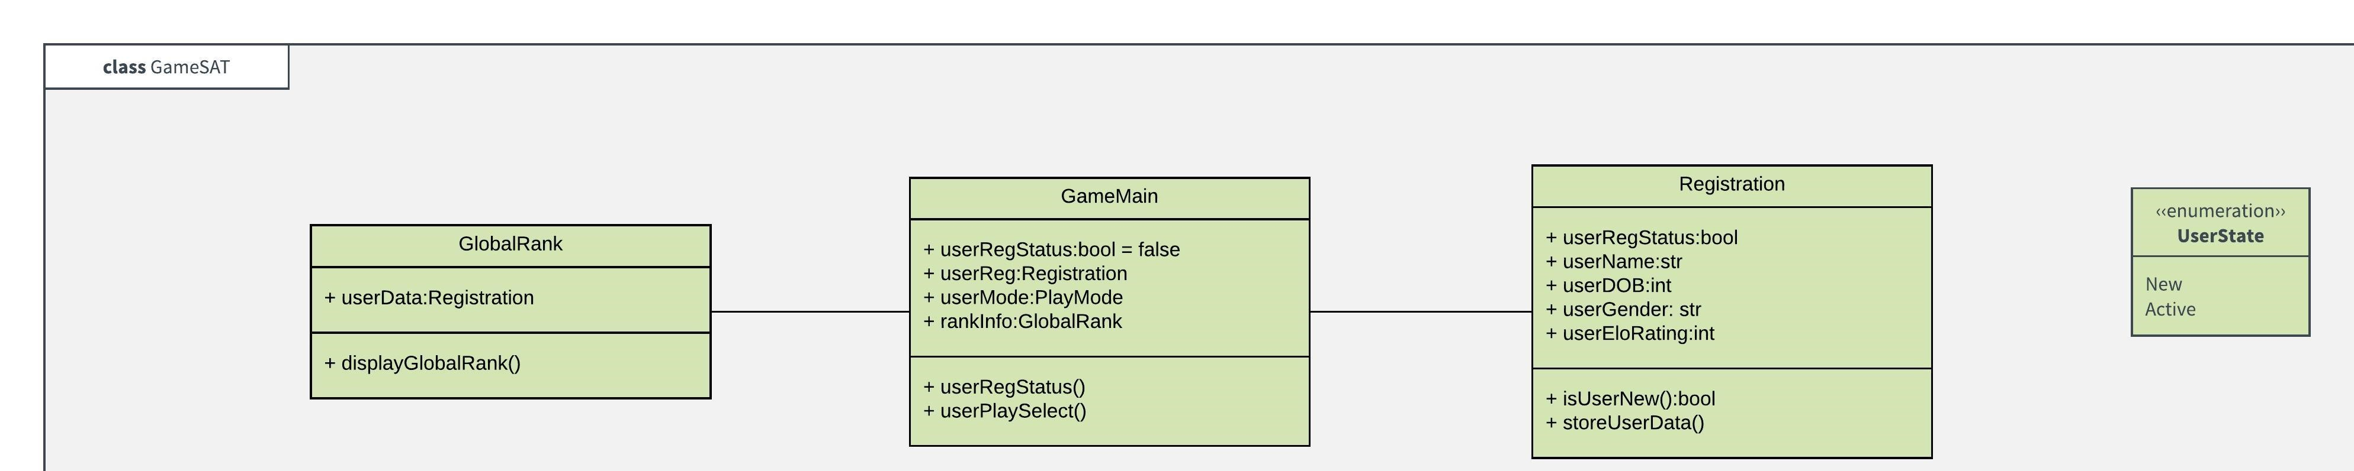
GameMain provides the user with an interactive interface
Registration allows the user to store their data
GlobalRank informs the user of the 10 highest scores
The user can be in a New state or an Active state

Slide 14
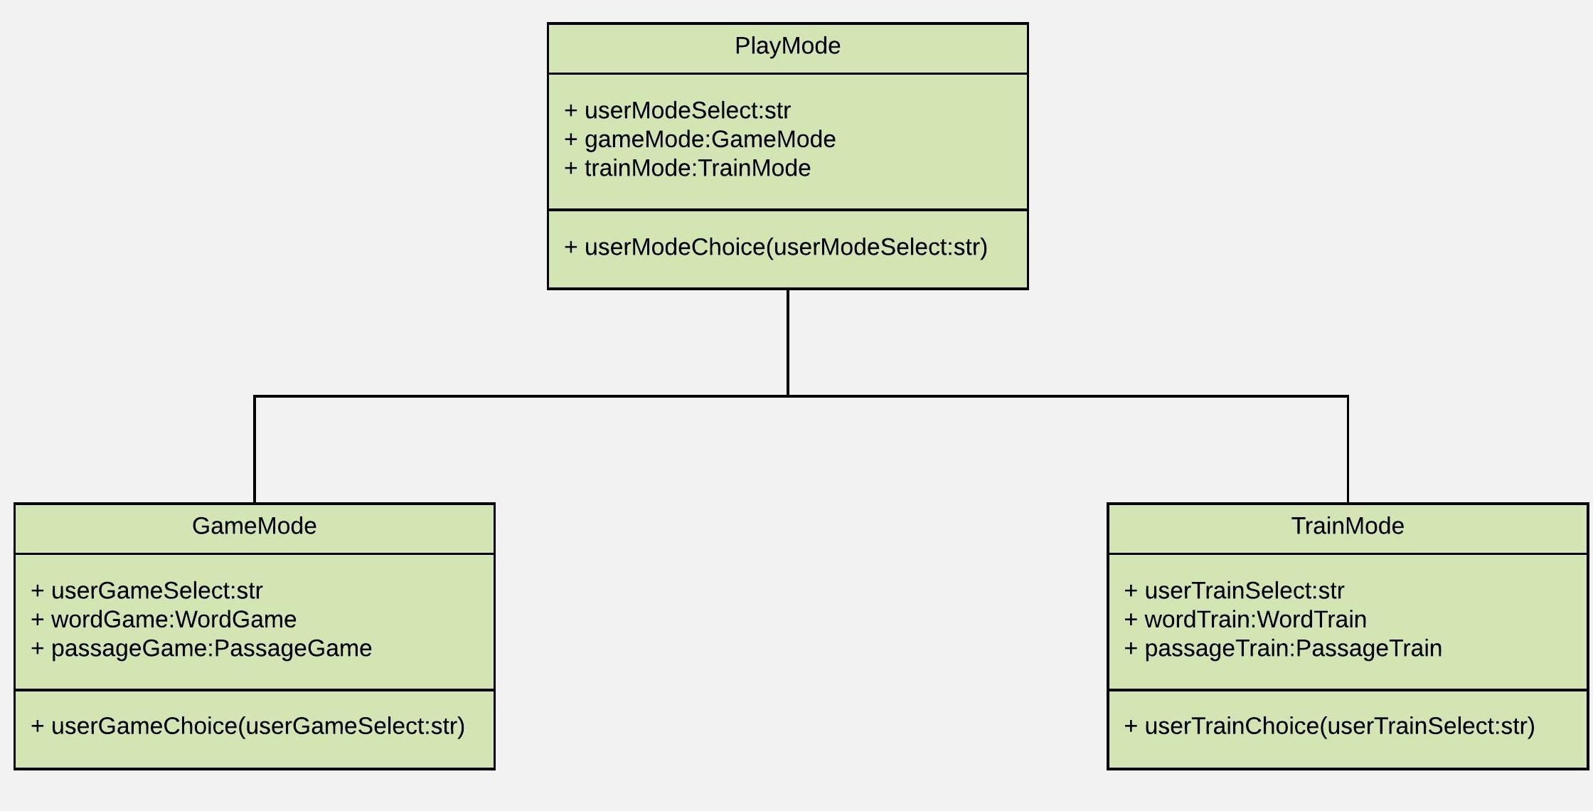
GameMain provides PlayMode with the user's choice
GameMode is activated when the user decides to play a game
TrainMode becomes active when the user selects to train instead

Slide 15
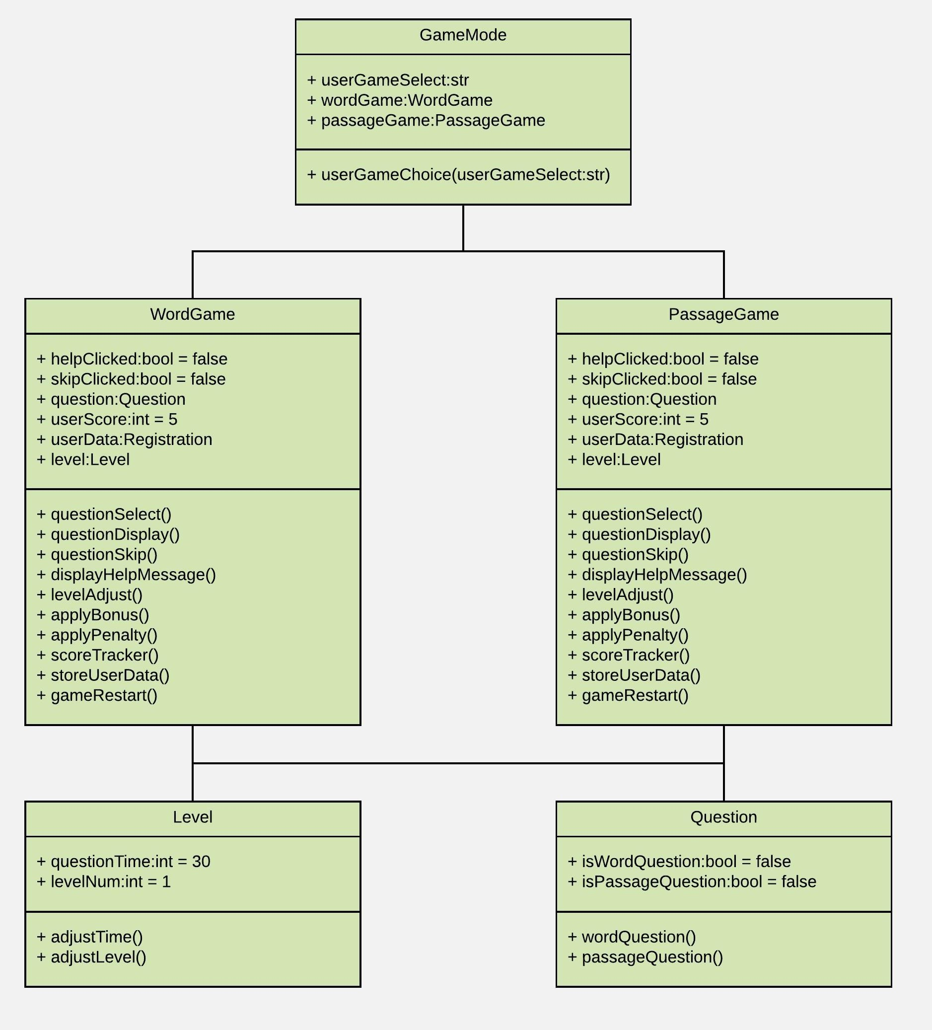
GameMode allows the user to play a word game or passage game
GameMode informs the user of their progress level
GameMode informs the user of each question's time limit
Association allows the user to know the global rank

Slide 16
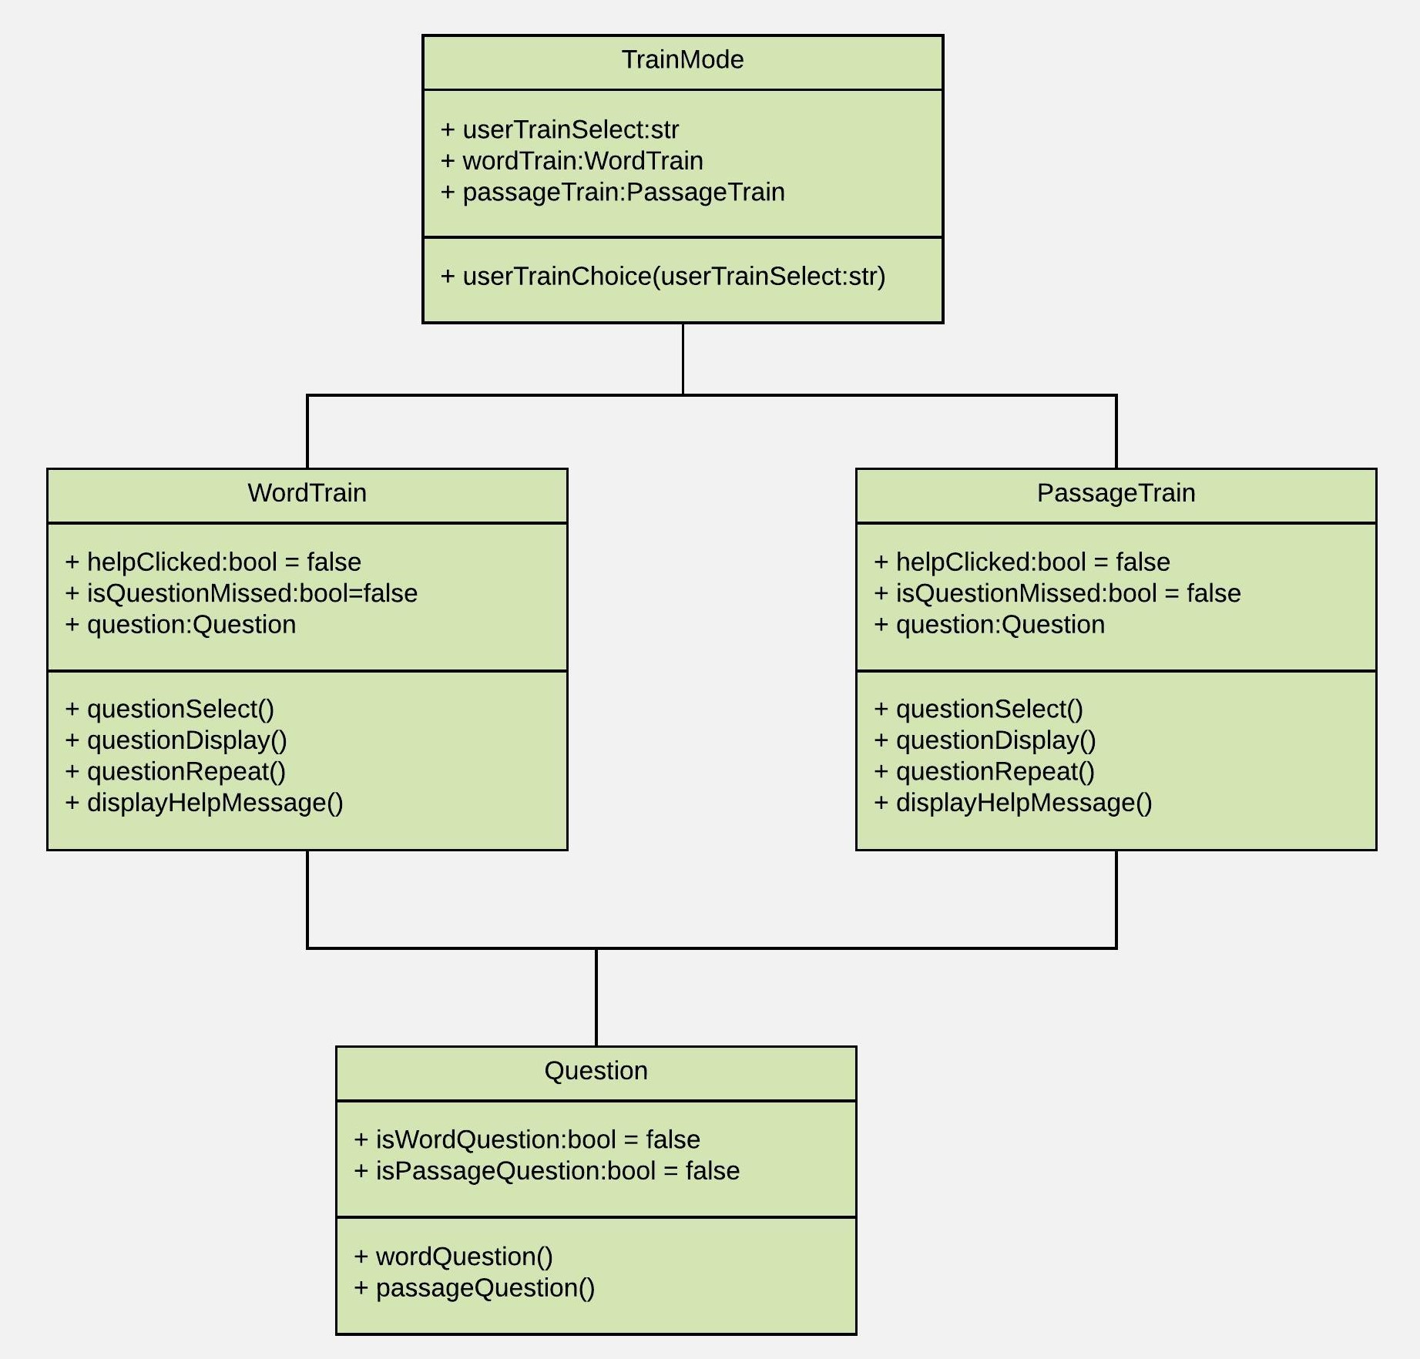
TrainMode allows the user to train their word vocabulary
TrainMode enables the user to train their passage comprehension
Train mode does not contain question time limits
Train mode does not score questions
Questions missed repeat more often

Slide 17
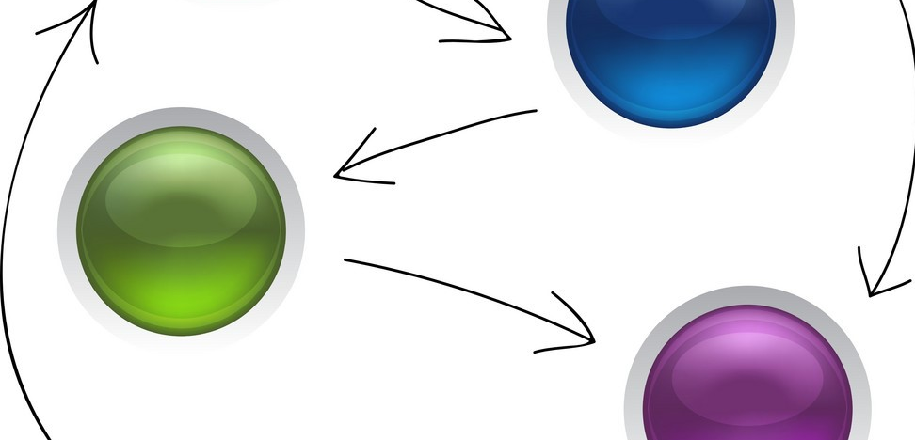
Sequence Diagrams

Slide 18
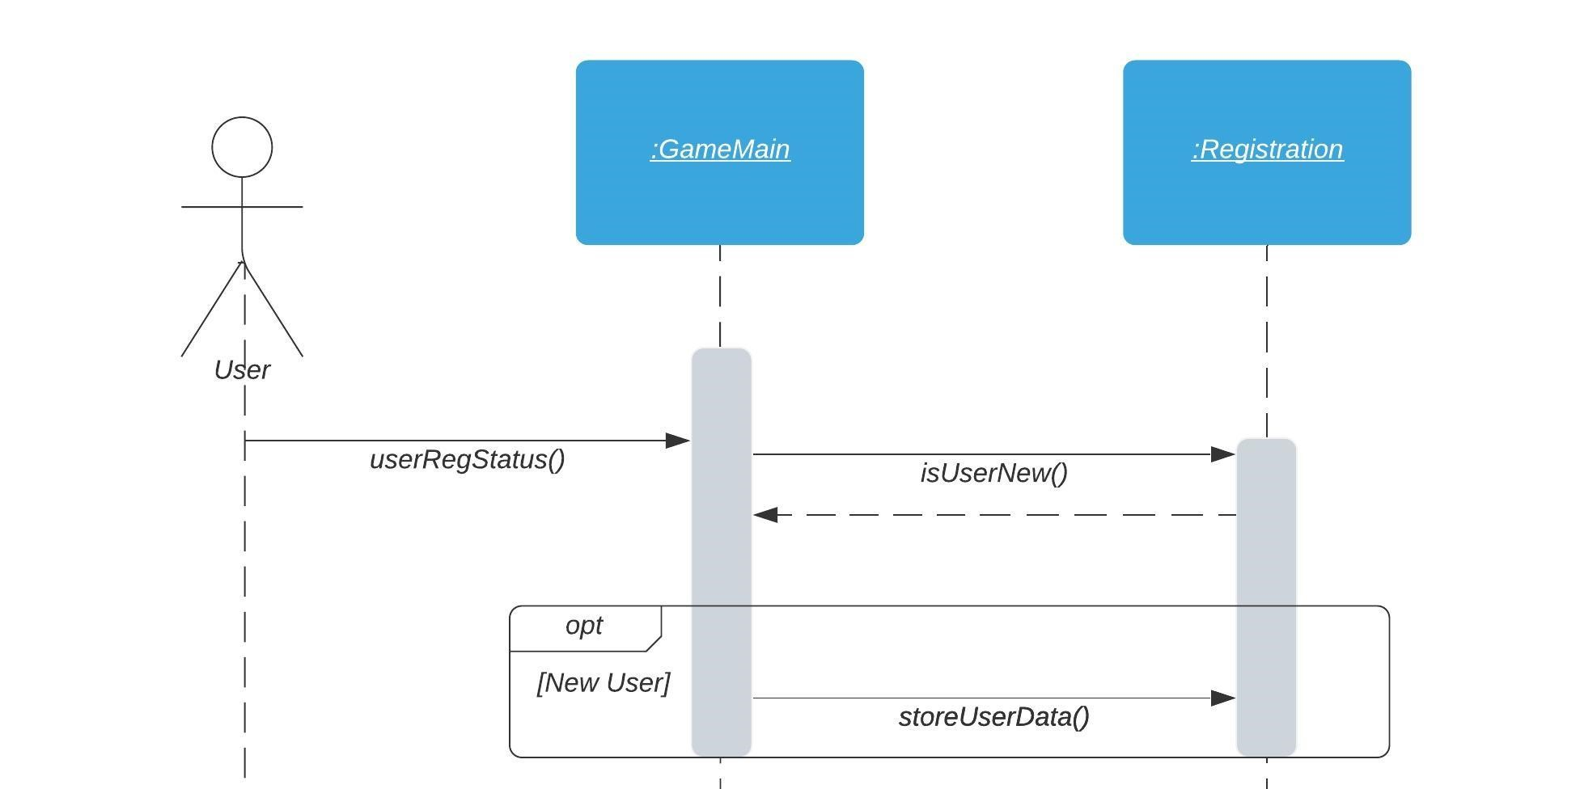
User provides their data to the main interface
If the user is new, their data is stored for further functions

Slide 19
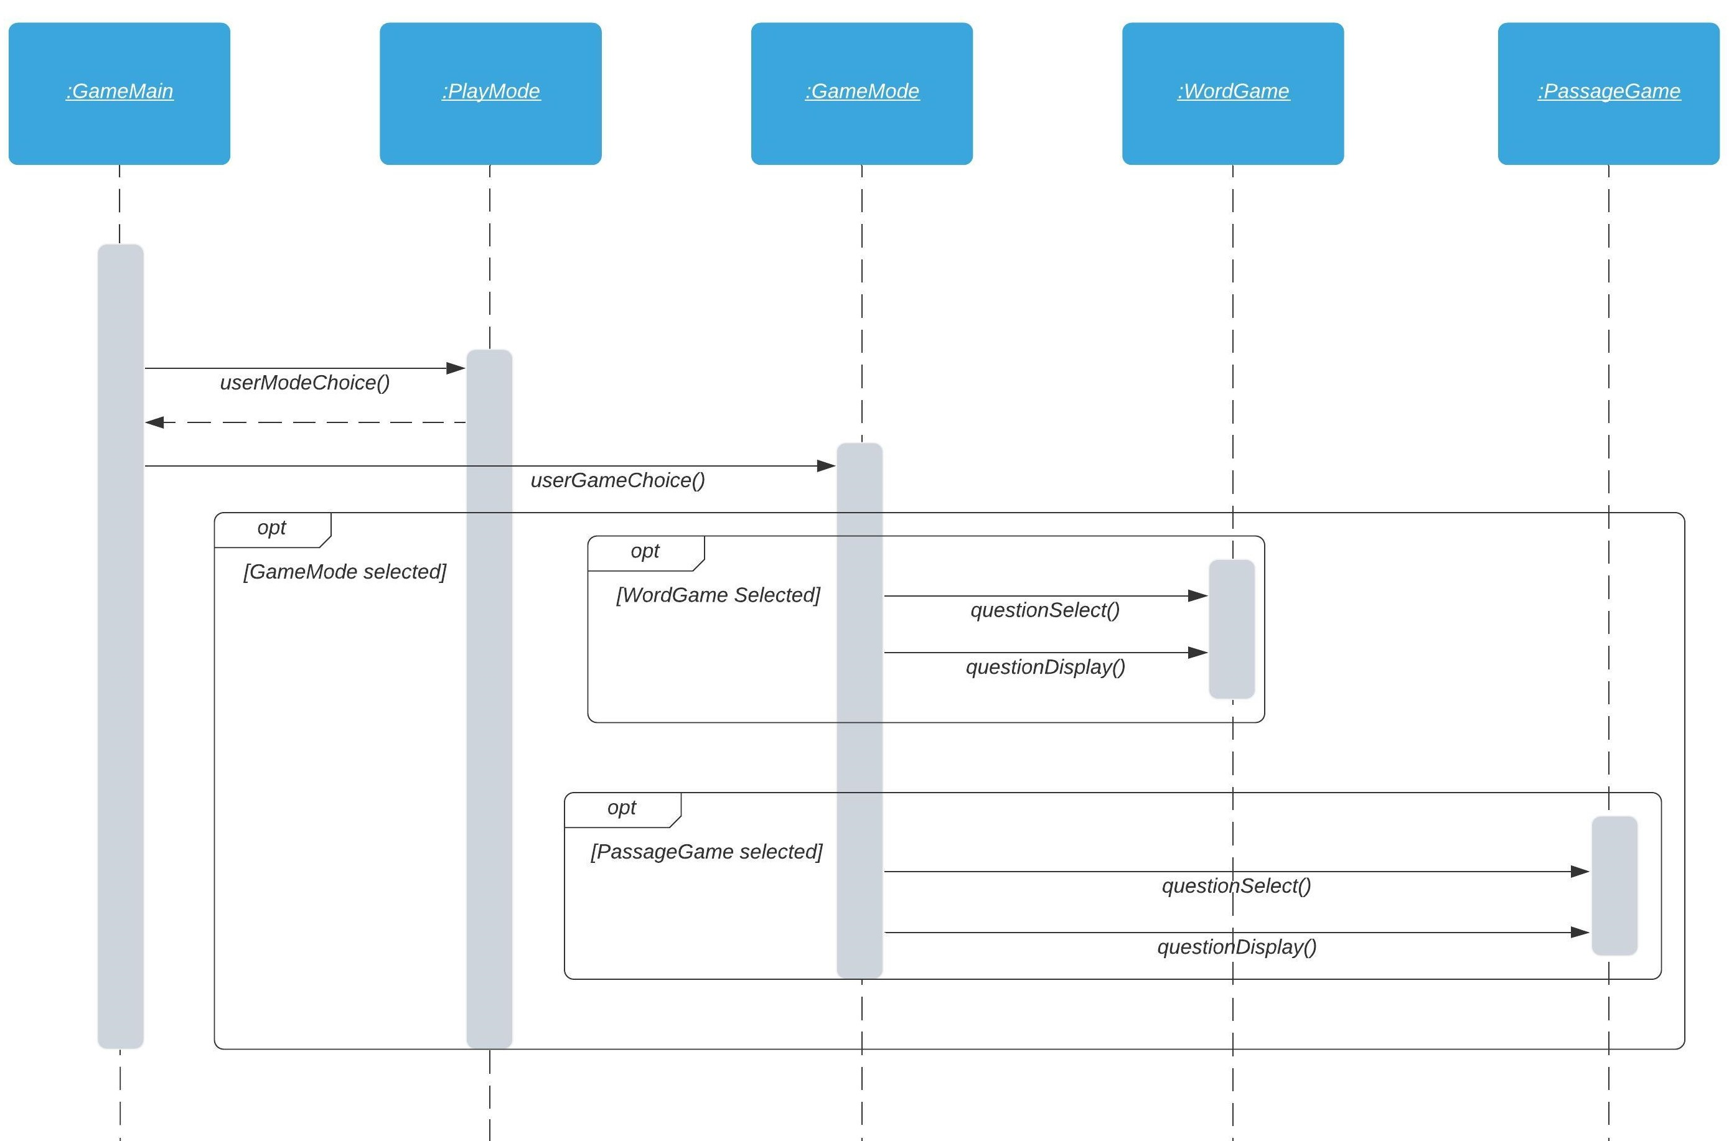
User selects PlayMode
In PlayMode the user can choose to play a word game, or a passage game

Slide 20
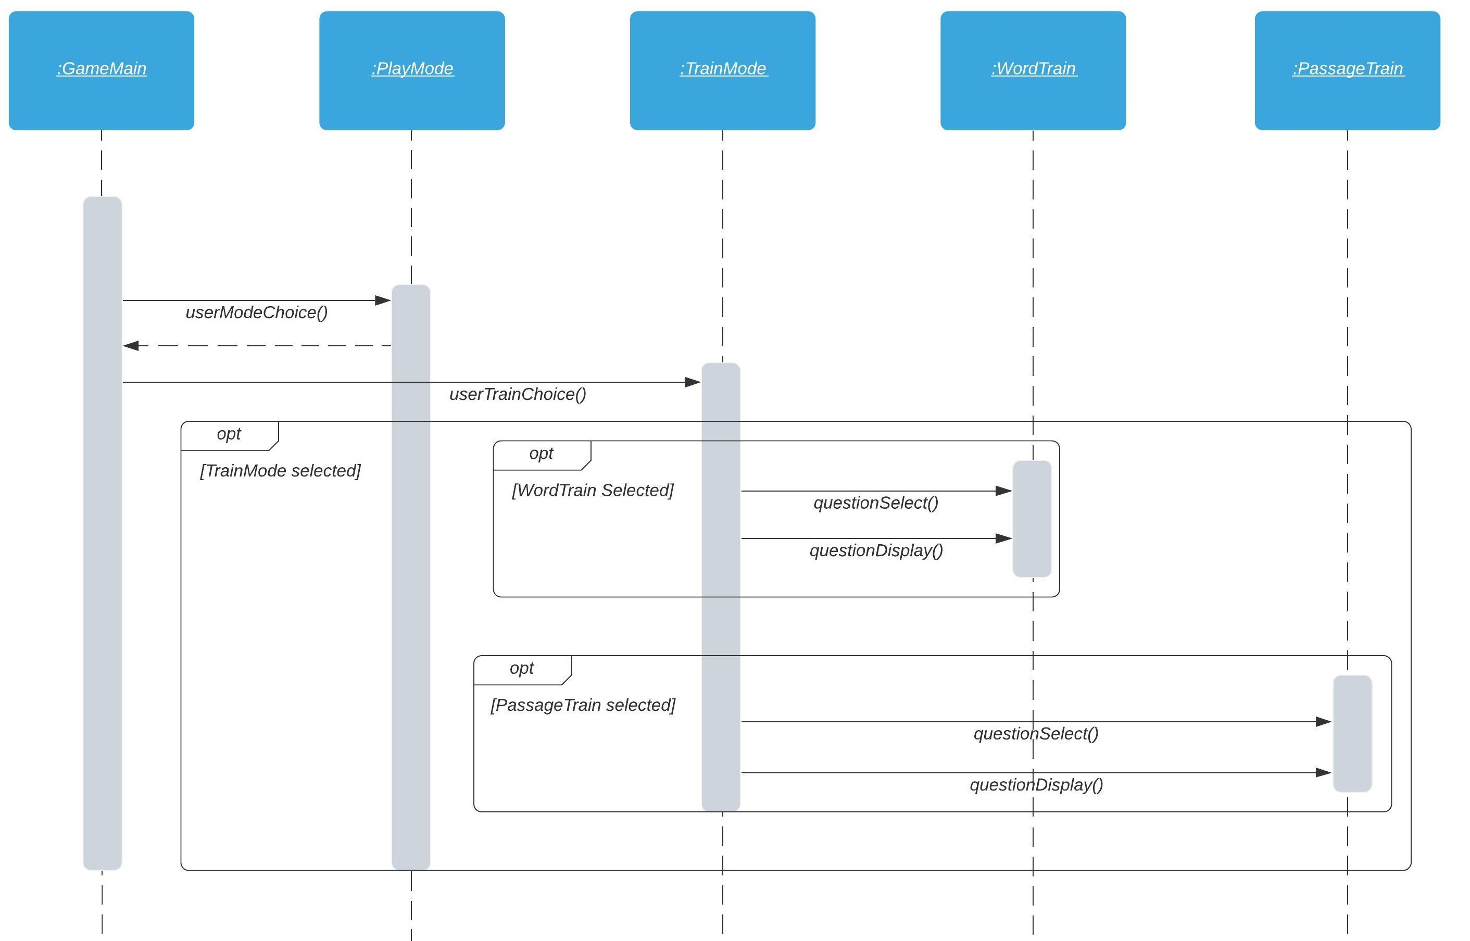
User selects TrainMode
In TrainMode the user can choose to train in word vocabulary, or in passage comprehension

Slide 21

System Architecture

Slide 22
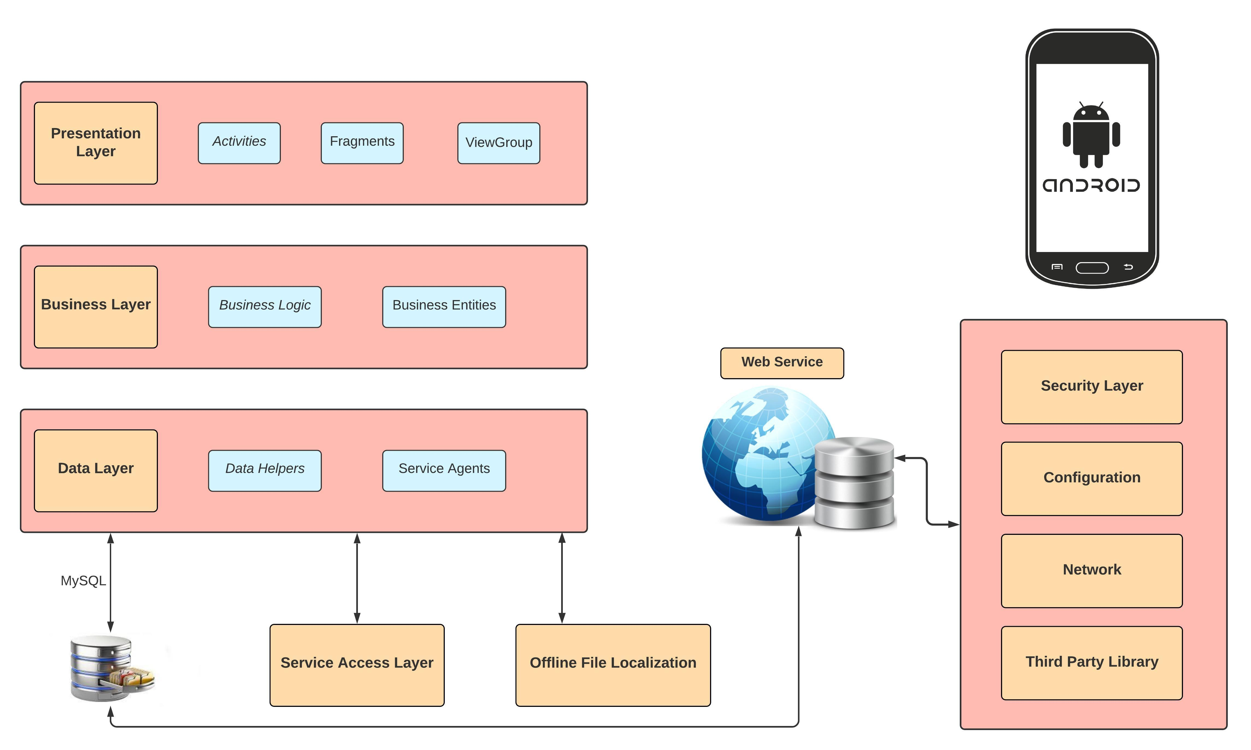

Slide 23
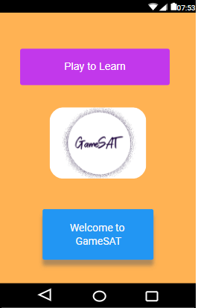
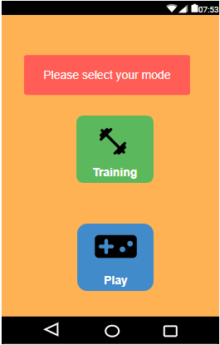
Mockup diagrams
Welcome screen and start screen

Slide 24
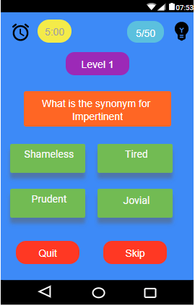
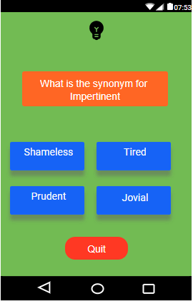
Training and Play mode

Slide 25
References
https://www.alamy.com/stock-photo-uml-unified-modelling-language-sequence-diagram-89308490.html
https://www.shutterstock.com/search/use+case+diagram

Slide 26

Thank You

